Slide 1
2024
Townhall

Slide 2
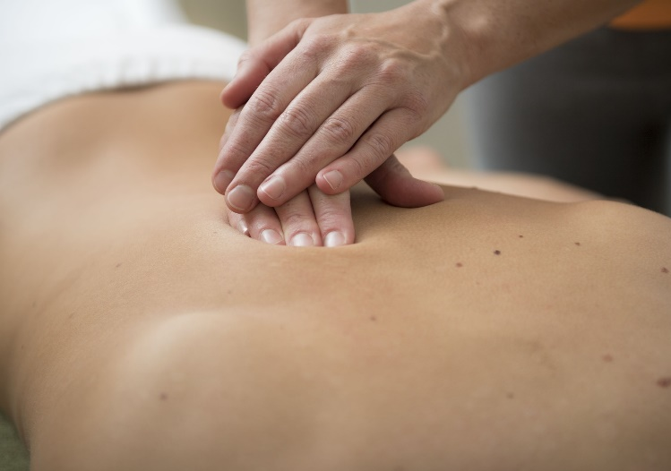
RMTAO Townhall
Looking Back on 2023
Built upon relationships with government officials, leading to a large number of important meetings.
Increasing recognition from government officials, insurance industry representatives, and other health professionals that massage therapy is a valuable health care option.
The more members we represent, the stronger our position will be when advocating for these issues.

Slide 3
RMTAO Townhall
2024 Member survey
Members felt the biggest issues impacting the massage therapy profession were:
Lack of inclusion in government health care initiatives,
Inconsistencies with insurance coverage for massage therapy.
Members continue to prioritize advocacy for tax exemption.

Slide 4
RMTAO Townhall
The RMTAO provides practical resources and educational courses to help RMTs to be successful in their practice, including:
Community-Based Networks.
Member programs such as discounts on accounting help or discounts on exercise videos that can be sent to patients.
Courses, programs and resources that are based on the needs and interests identified by members.
Fee Survey highlighting average fees.

Slide 5
RMTAO Townhall
Interprofessional Collaboration
The RMTAO has entered into a partnership with the West Toronto Community Health Services (WTCHS).
To further advance our goal of supporting the participation of RMTs in interprofessional teams.
The RMTAO has embedded 2 RMTs into the integrated, team-based primary care team.
Results will be presented in the next few months.
Primary Care Summit
On February 22-23, 2024, the RMTAO attended and presented at the Team Primary Care (TPC) Summit in Ottawa about the WTCHS Pilot Project.
The summit was attended by 200 people in person, and 100 joined virtually.
The feedback from participants has been overwhelmingly positive.

Slide 6
RMTAO Townhall
Pilot Project Videos
The RMTAO is developing a series of at least four videos highlighting the impact of this pilot project on both practitioners and patients.

Slide 7
RMTAO Townhall
Queen's Park Day
Our first Queen’s Park Day since late 2018 was held in February and was a tremendous success.
Our 28-member team carried three strong messages to meetings with MPPs, focusing on RMTAO’s primary issues and concerns, including:
The need to include massage therapy in community health teams across Ontario,
HST exemption for RMTs,
The difficulties of obtaining third-party sign-off for treatment plans related to motor vehicle accident insurance claims (OCF-18).
MPP France Gelinas introduced a Bill, which will now go through the legislative process, will, ultimately, make the third Wednesday of every October henceforth known as “Massage Therapy Day” in the province.
RMTAO volunteers were busy meeting with 23 MPPs, 18 Queen’s Park staffers, and supporters.

Slide 8
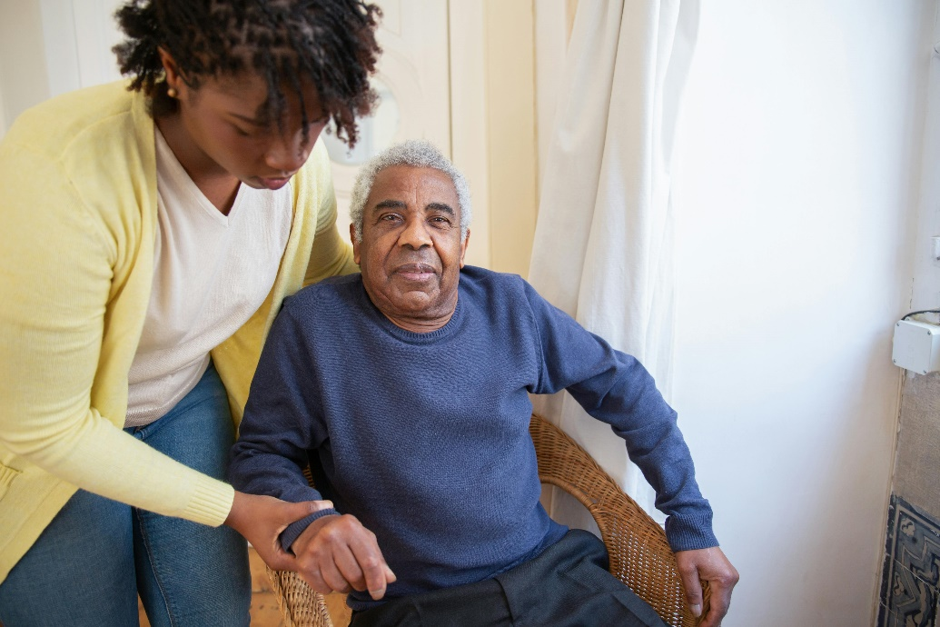
RMTAO Townhall
Long-Term Care Meetings
Recently met with 2 Long Term Care Assistant Deputy Ministers (ADMs) recently.
We discussed the Pilot Project, which introduced 2 RMTs into the West Toronto Community Health Service.
They were particularly interested in how RMTs in primary care settings can help keep seniors healthy and at home longer.

Slide 9
RMTAO Townhall
Insurance Companies
Meetings with senior leaders from insurance companies to discuss inconsistencies with massage therapy coverage.
Insurance industry leaders provided insight into delisting practices.
Insurance companies agreed to continue to meet with RMTAO to develop a better understanding of the delisting process.
Contacted CEOs of the large insurance companies to remove the requirement for a physician referral to receive massage therapy.
Many insurance companies and the Canadian Health and Life Insurance Association (CHLIA) have indicated that they hope to move away from having this requirement.
CHLIA will continue to discuss the physician referral issue.

Slide 10
RMTAO Townhall
Scholarships
The RMTAO funded one $10,000 Masters Grant student to help further expand the massage therapy research base.
Next year, we are looking into funding 1 Masters Grant, 4 BA Grants and 1 Indigenous High School grant to become an RMT.

Slide 11
RMTAO Townhall
Participated in a variety of interprofessional groups including:
CORHPA
Continue to participate in the Coalition of Ontario Regulated Health Professional Associations (or CORHPA) to discuss issues such as:
Barriers in the insurance industry
Proposed changes in healthcare regulation
Government bills that can impact health professionals

Slide 12
RMTAO Townhall
CMTO
Regularly meet to discuss issues such as:
Risk Based Assessment
Treatment of spouses
Regulatory reform
Concerns about fees
Health History Forms
CMTO and Prometric
Meetings discussing entrance-to-practice exams.

Slide 13
RMTAO Townhall
WSIB
Chair of the Coalition of Health Professions in Auto Insurance and the Workplace Safety and Insurance Board (WSIB) Health Professionals Forum.
Secured a 4.2% increase in fees, among other reforms.
Coalition of Health Professions in Auto Insurance (Auto Coalition)
After reviewing Health Service Provider Guidelines and Frameworks, the government is committed to ensuring that those injured in auto accidents continue to receive the care they need and that health service providers are compensated appropriately for their services.

Slide 14
RMTAO Townhall
HST exemption
Unfortunately, the April16, 2024 Federal Budget did not include provisions to exempt massage therapy from collecting and remitting HST/GST.
The RMTAO and the CMTA have made hundreds of meetings, emails, letters, phone call and texts and many politicians across Canada have been supportive.
A petition circulated from December 11, 2023, to April 9, 2024 garnered 18,382 signatures from across Canada, in support of HST/GST exemption.
While we are disappointed with the lack of action, the RMTAO remains steadfast in our efforts to gain exemption.

Slide 15
RMTAO Townhall
HST tax exemption cont.
We have been in touch with the Ministry of Finance who are willing to talk about the HST proposal in the lead up to the Fall Economic Statement in November and the 2025 Budget.
We have reached out to national and provincial media and will continue to press the government for an exemption to be included this fall.
If need be, we will also make HST exemption an issue for the next federal election mandated on or before October 2026.

Slide 16
RMTAO Townhall
RMTAO Focus
Our focus is to make it easier for RMTs to do their very important jobs. This can be achieved by:
Spreading the word about the diverse benefits of massage therapy through all of our channels.
Advocacy to ensure that RMTs are included in all relevant areas of health care and are recognized and respected as valuable health professionals.
Making it easier for patients to access massage therapy by removing the barriers to access put in place by some insurance companies.
Continuing to fight to remove the barrier imposed on patients by having to pay HST.

Slide 17
RMTAO Townhall
The RMTAO
Acts as the voice of the massage therapy profession in health care.
Helps the profession move above and beyond any previous expectation.
Will continue to maintain strong relationships with the government, the insurance industry, the regulator and other health professionals to ensure that massage therapy can be on the forefront of healthcare.
Thank you

Slide 18
2024
Townhall

